Slide 1
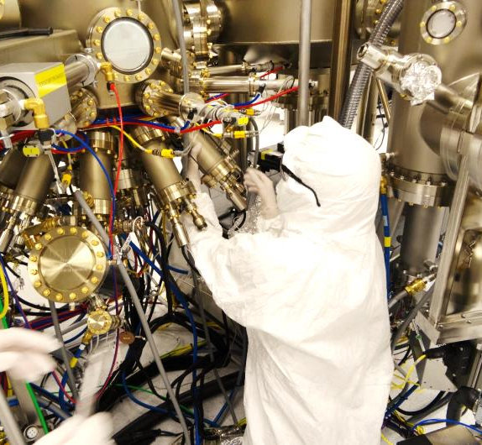
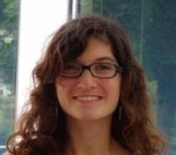
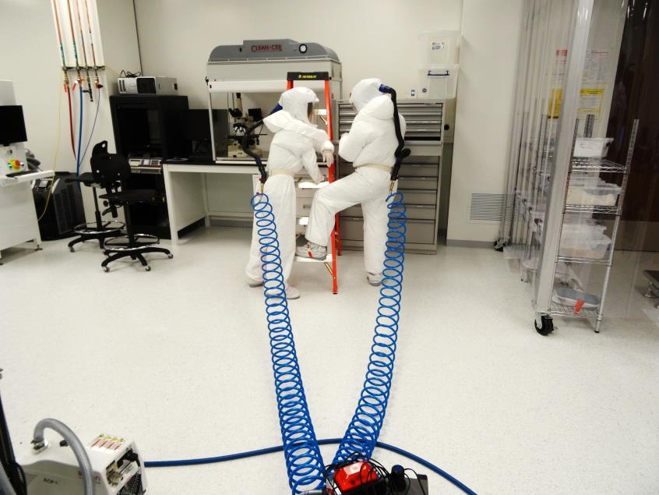
ESR 10 :
Julie TOURNET
WP3: Materials for Energy
Project 3.2 : MBE growth of metamorphic III-Sb on Si for CPV solar cells

Slide 2
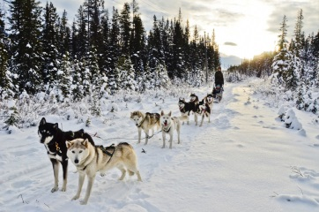
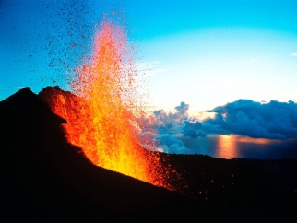
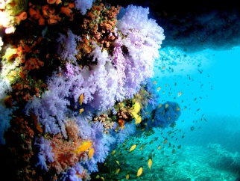
Canada
(2012-two weeks ago!)
France
(2007-2011)
BSc Engineering
Spain
(2012)
MASc Nano
Erasmus
Reunion Island (1990-2007)

Slide 3
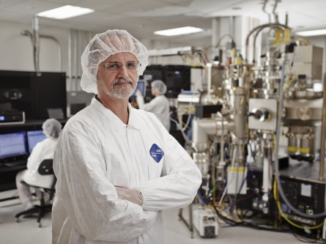
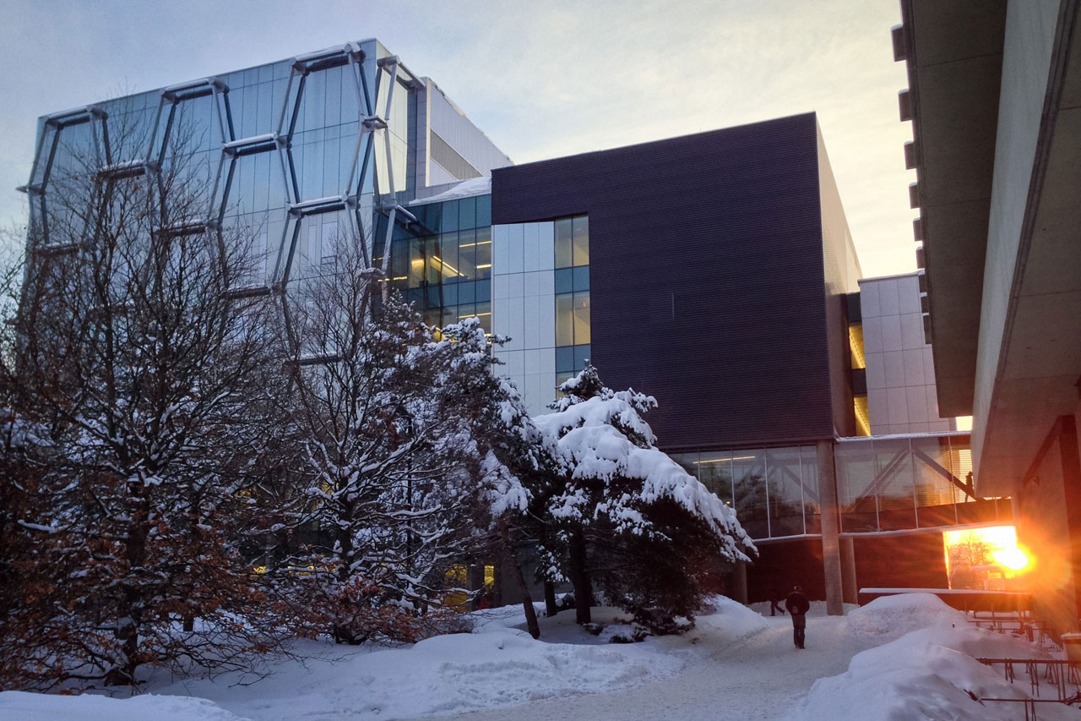
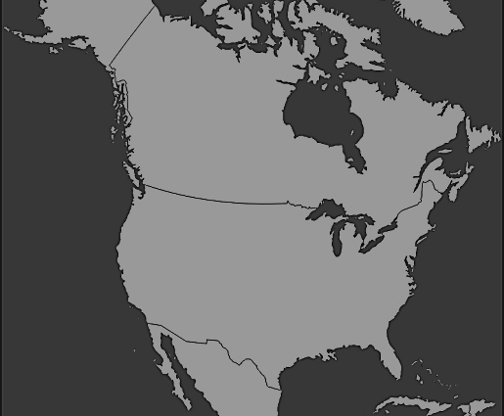
MBE Lab
Z.R. Wasilewski
---
Veeco GEN10
in-situ and ex-situ characterization facilities
Quantum Nano-Center
Waterloo Institute for Nanotechnology
Institute for Quantum Computing

Slide 4
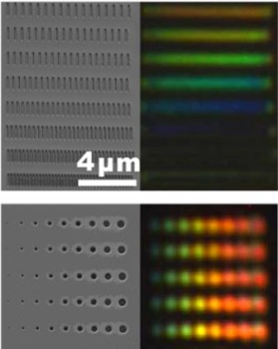
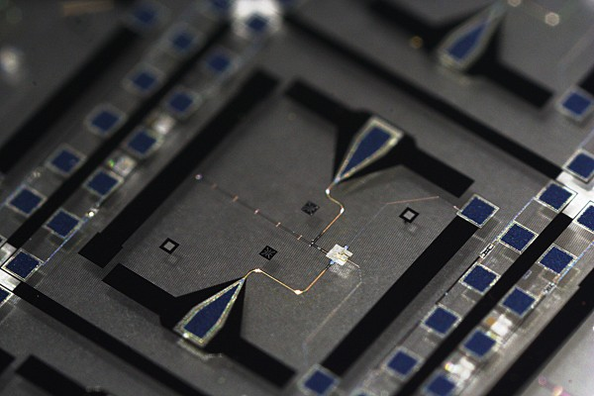
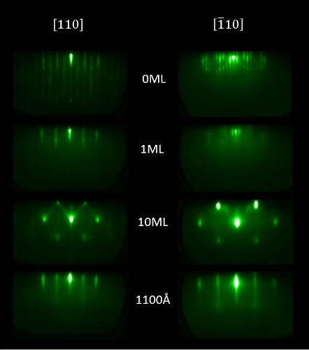
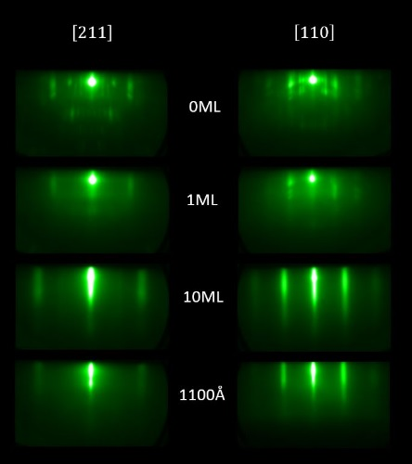
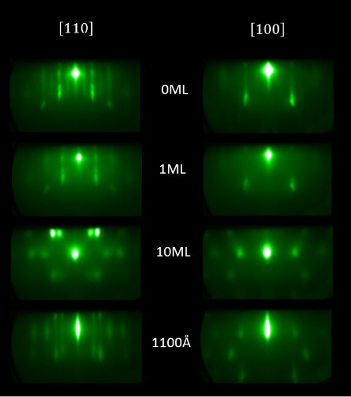
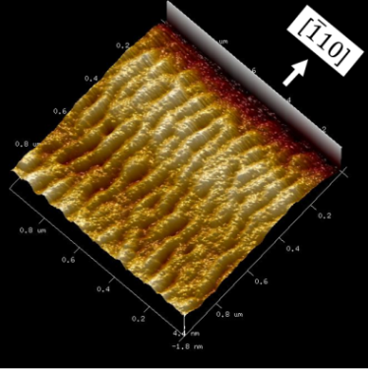
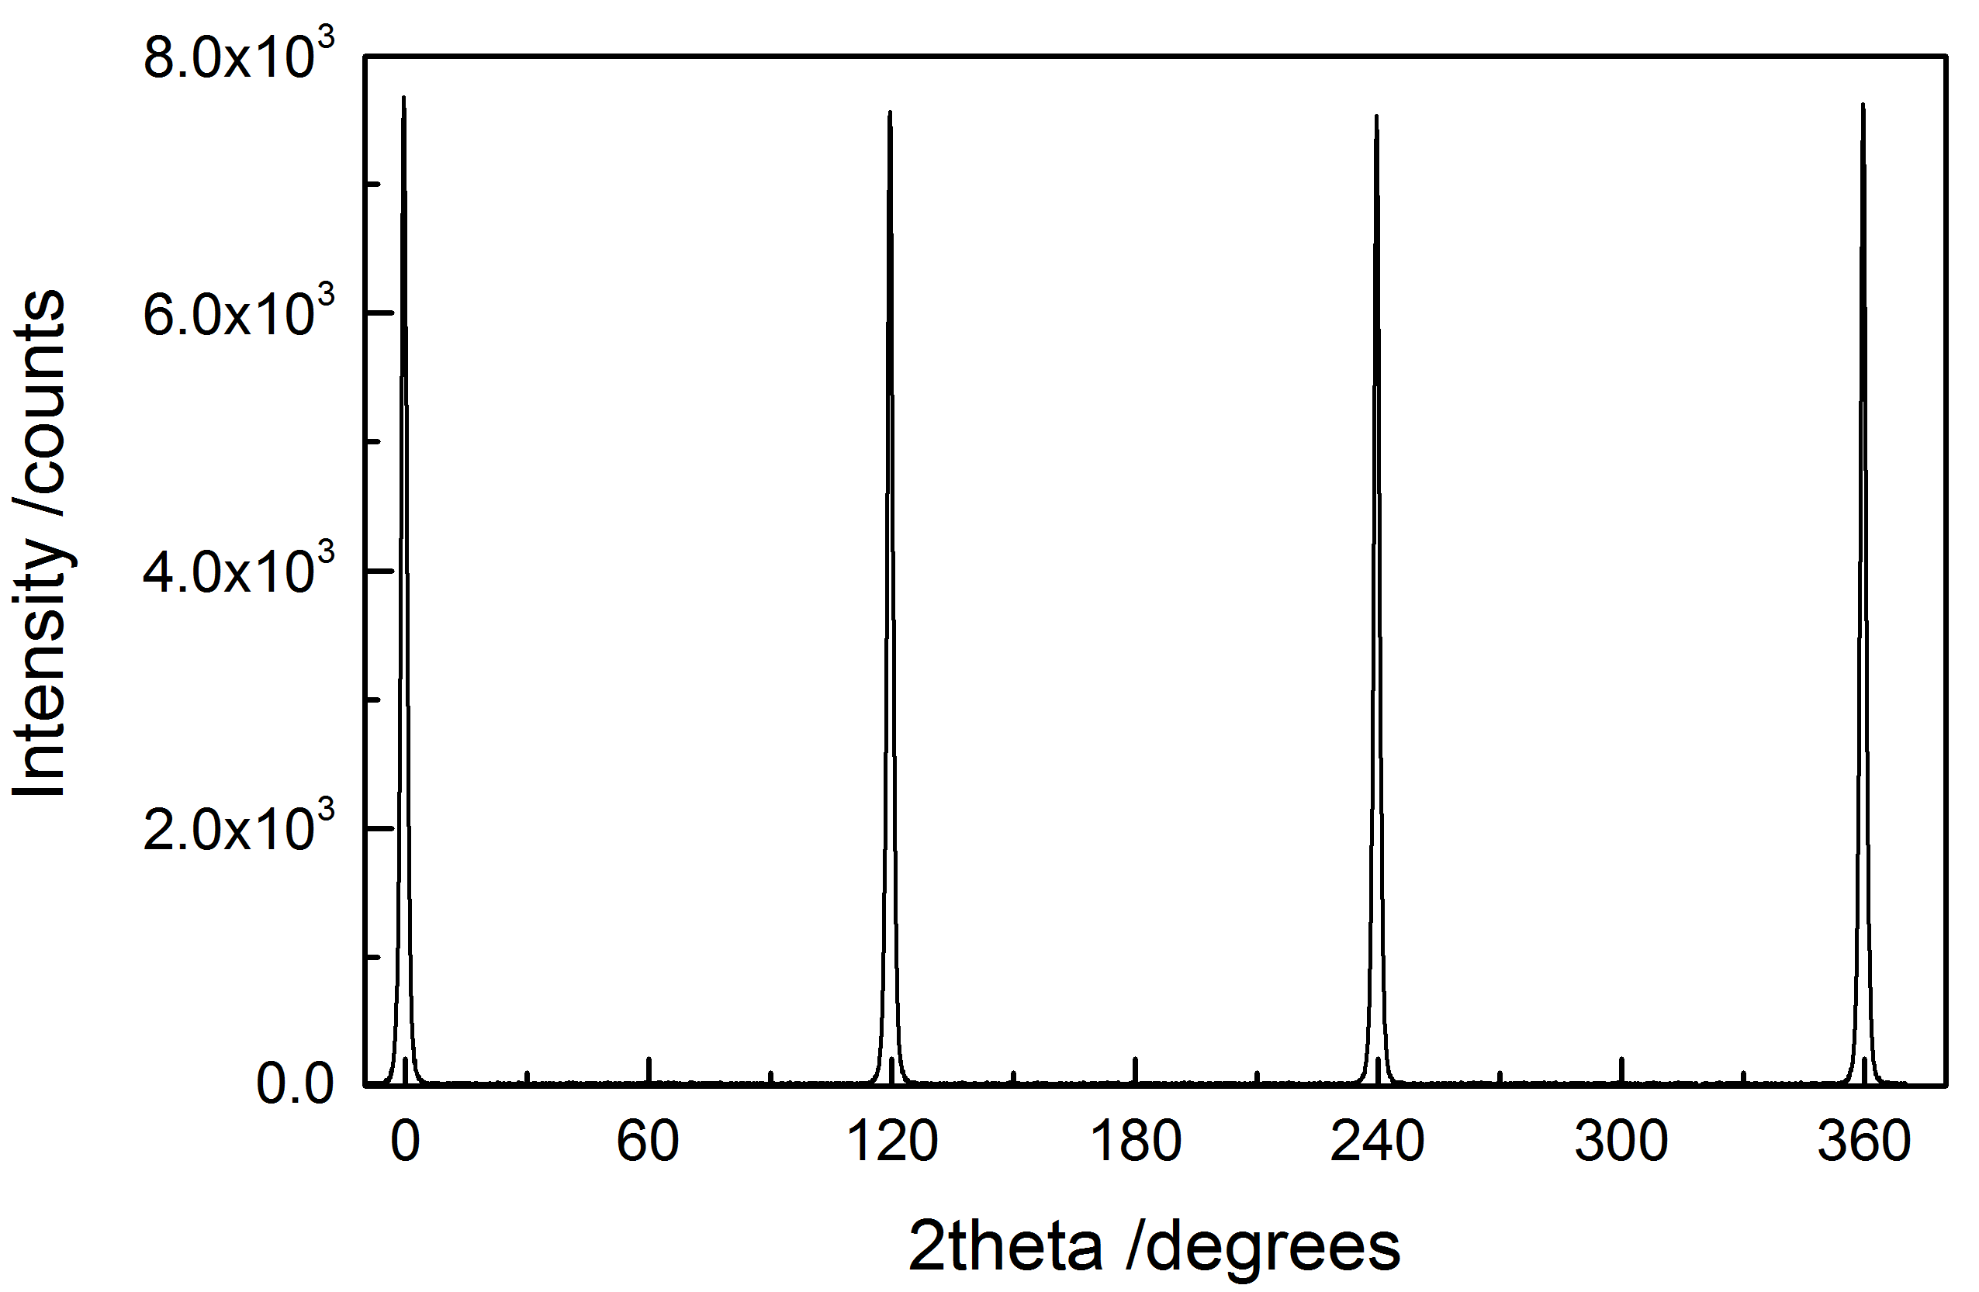
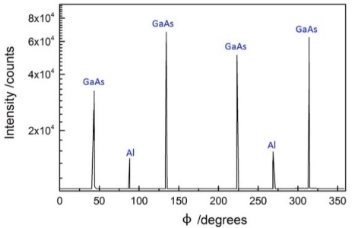
Graduate research :
MBE growth and characterization of Aluminum on semiconductors (Si, GaAs)
Applications:
quantum computing
single-photon detectors
plasmonics
In-situ monitoring with RHEED revealing various growth modes
XRD analysis
AFM observation.
RMS roughness 0.6nm

